Slide 1
ATAI
Advanced Techniqueof Artificial Intelligence
ATAI
ChongqingUniversity _{AdvancedTechniqueof}
of Technology Artificial Intelligence
Chongqing University of
Technology
Chongqing University ^{ATAI}
_{of Technology} Advanced Techniqueof
Artificial Intelligence
Chongqing University of Technology
Chongqing University of Technology
PTSR: Prefix-Target Graph-based Sequential Recommendation
code: https://github.com/TosakRin/PTSR.
—— CIKM 2024
Reported by ZhenDong Huang
1

Slide 2
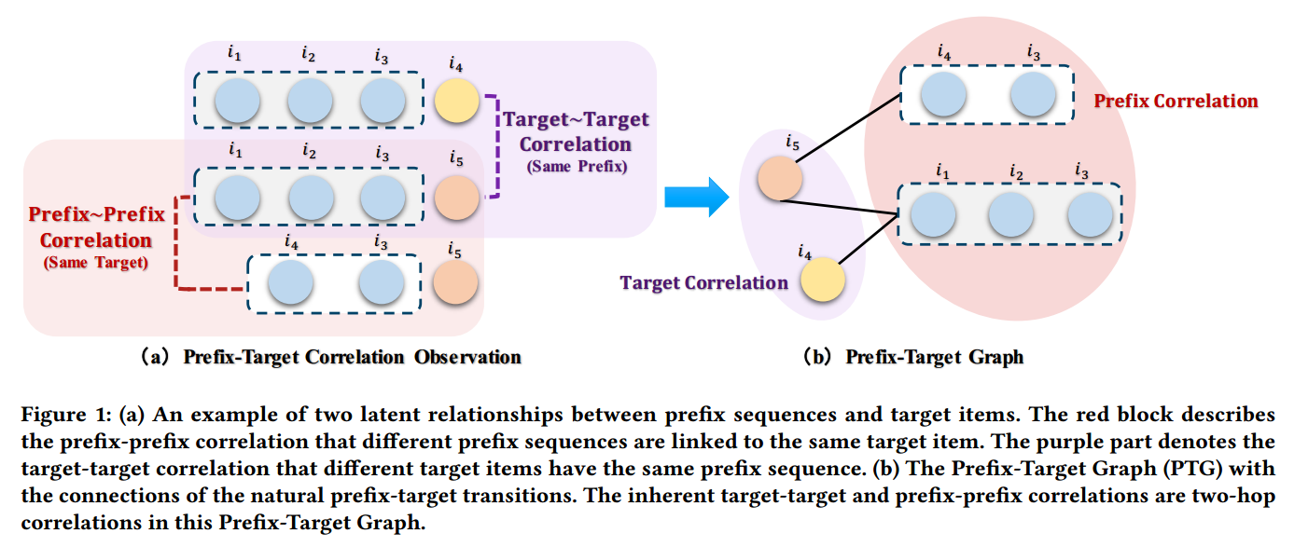
ATAI
AdvancedTechniqueof
Artificial Intelligence
ATAI
ChongqingUniversity _{AdvancedTechniqueof}
of Technology Artificial Intelligence
ChongqingUniversity of Technology
Motivation
1)These methods primarily model the correlations between prefixes and targets but often
neglect the inherent correlations among prefixes and items.

Slide 3
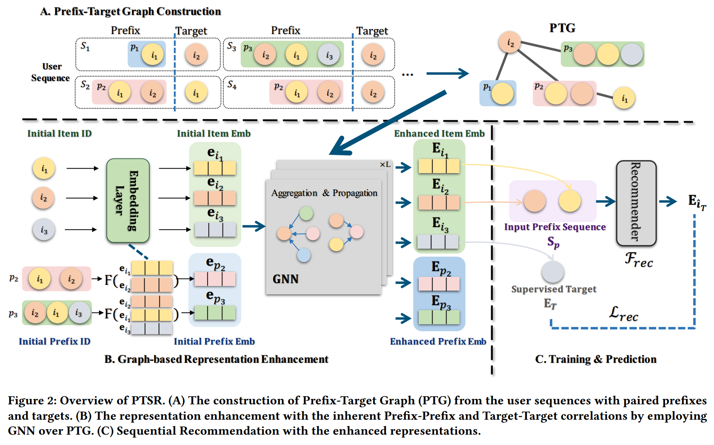
ChongqingUniversity of Technology
ATAI
AdvancedTechniqueof
Artificial Intelligence
ATAI
ChongqingUniversity _{AdvancedTechniqueof}
of Technology Artificial Intelligence
Overview

Slide 4
ChongqingUniversity of Technology
ATAI
AdvancedTechniqueof
Artificial Intelligence
ATAI
ChongqingUniversity _{AdvancedTechniqueof}
of Technology Artificial Intelligence
Method

Slide 5
ChongqingUniversity of Technology
ATAI
AdvancedTechniqueof
Artificial Intelligence
ATAI
ChongqingUniversity _{AdvancedTechniqueof}
of Technology Artificial Intelligence
Method

Slide 6
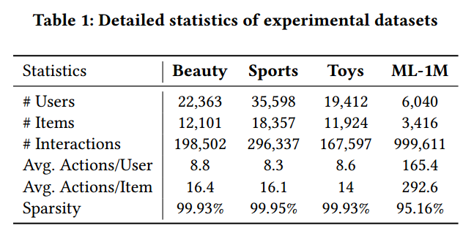
ATAI
AdvancedTechniqueof
Artificial Intelligence
ATAI
ChongqingUniversity _{AdvancedTechniqueof}
of Technology Artificial Intelligence
ChongqingUniversity of Technology
Experiments

Slide 7
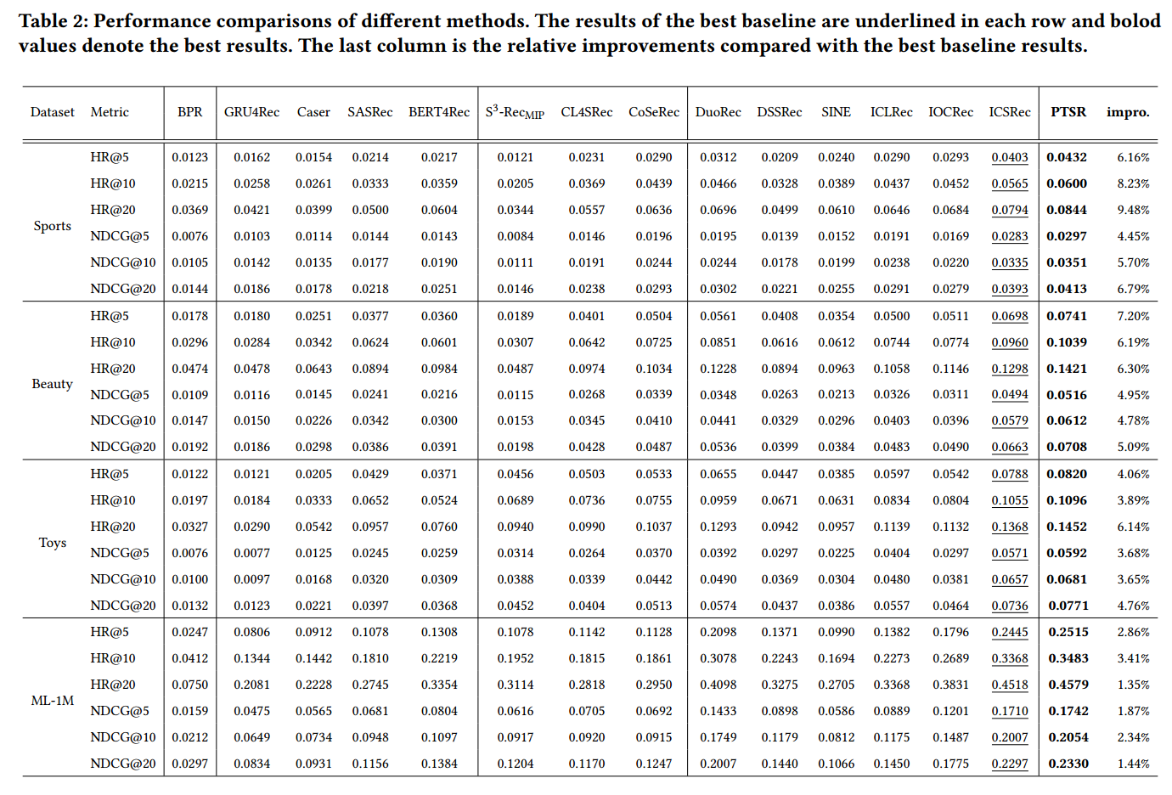
ATAI
AdvancedTechniqueof
Artificial Intelligence
ATAI
ChongqingUniversity _{AdvancedTechniqueof}
of Technology Artificial Intelligence
ChongqingUniversity of Technology
Experiments

Slide 8
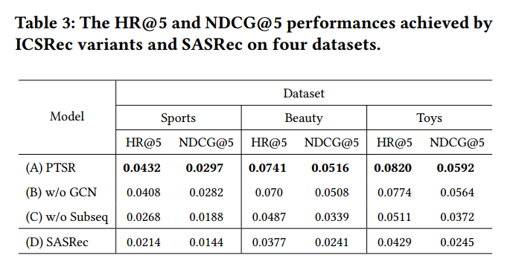
ATAI
AdvancedTechniqueof
Artificial Intelligence
ATAI
ChongqingUniversity _{AdvancedTechniqueof}
of Technology Artificial Intelligence
ChongqingUniversity of Technology
Experiments

Slide 9
ATAI
AdvancedTechniqueof
Artificial Intelligence
ATAI
ChongqingUniversity _{AdvancedTechniqueof}
of Technology Artificial Intelligence
ChongqingUniversity of Technology
Experiments

Slide 10
ATAI
AdvancedTechniqueof
Artificial Intelligence
ATAI
ChongqingUniversity _{AdvancedTechniqueof}
of Technology Artificial Intelligence
ChongqingUniversity of Technology
Experiments

Slide 11
ATAI
AdvancedTechniqueof
Artificial Intelligence
ATAI
ChongqingUniversity _{AdvancedTechniqueof}
of Technology Artificial Intelligence
ChongqingUniversity of Technology
Experiments

Slide 12
ChongqingUniversity of Technology
ATAI
AdvancedTechniqueof
Artificial Intelligence
ATAI
ChongqingUniversity _{AdvancedTechniqueof}
of Technology Artificial Intelligence
Thanks!

